Slide 1
Immune System
Sid K

Slide 2
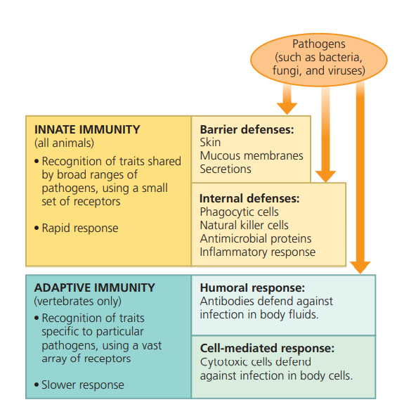
Innate vs Adaptive Immunity

Slide 3
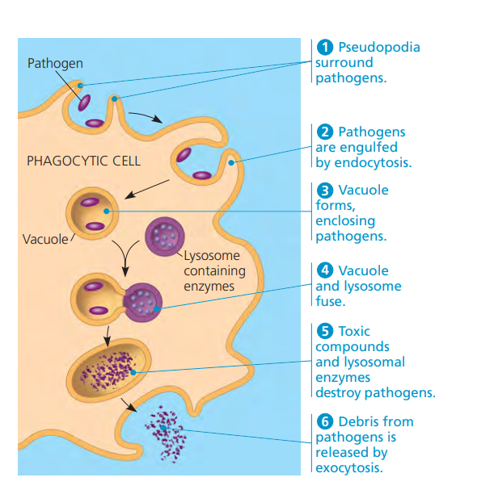
Phagocytosis
Phagocytosis is a type of innate immunity that involves the digestion of antigens.
In insects, it is conducted by cells called hemocytes and in vertebrates, it is mainly conducted by macrophages.

Slide 4
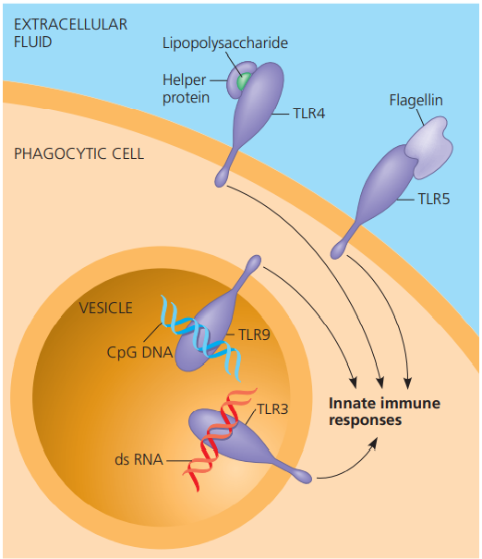
Toll Receptors and Toll-Like Receptors
When a fungus infects a fruit fly, pieces of the fungal cell wall will bind to a fungal recognition protein. This activates the Toll protein, which activates antimicrobial peptides.
Vertebrates have a similar mechanism. Toll-Like receptors detect a variety of different pathogens.

Slide 5
Phagocytic cells and Antimicrobial Peptides
Neutrophils are most abundant, have a short life span, and self-destruct upon phagocytosis
Monocytes are immature cells that are “activated” into macrophages by phagocytosis
Macrophages circulate in the blood, or filter blood in spleen/lymph in lymph nodes
Eosinophils are found in mucous membranes, release enzymes against multicellular parasites
Dendritic cells are found in skin and other barriers.
Natural Killer Cells detect abnormal surface proteins and release chemicals to cause cell death.
Interferons are secreted by body cells, which induce nearby uninfected cells to produce substances that inhibit viral reproduction.
The complement system consists of 30 proteins that are activated by substances on the surface of microbes

Slide 6
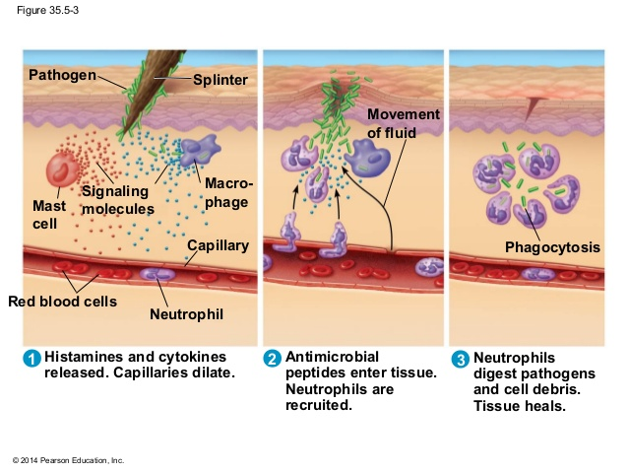
Inflammatory Response

Slide 7
Adaptive Immunity Basics
The adaptive response consists of T cells and B cells, which are lymphocytes.
Lymphocytes that migrate from the bone marrow to the Thymus are T cells.
Lymphocytes that remain in the bone marrow are B cells.
An antigen is a molecule that elicits a response from a B cell or T cell.
A B cell or T cell binds to an antigen via an antigen receptor.
The portion of the antigen that binds to the antigen receptor is an epitope.

Slide 8
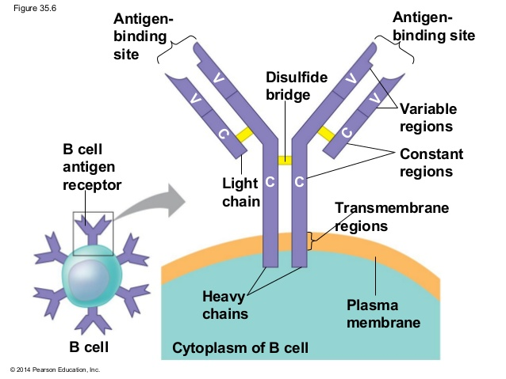
B cell receptor

Slide 9
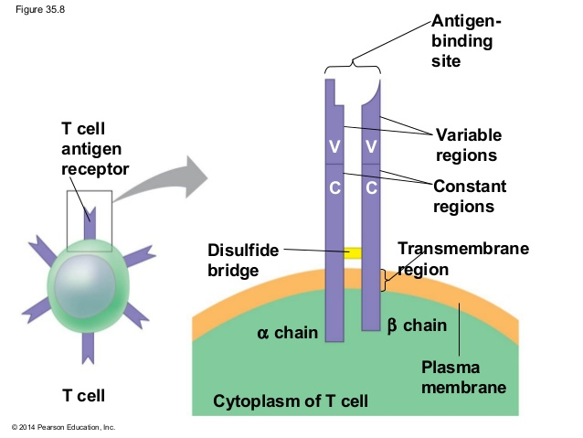
T cell receptors

Slide 10
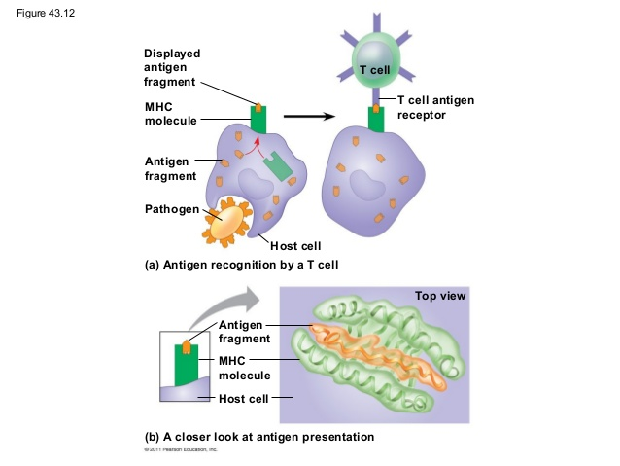
MHC molecules
A pathogen is taken in by a host cell. Enzymes in the host cell cleave the antigen into smaller peptides.
MHC molecules display the antigen on the cell surface.
T cells bind to the antigen, which is presented through the MHC molecule

Slide 11
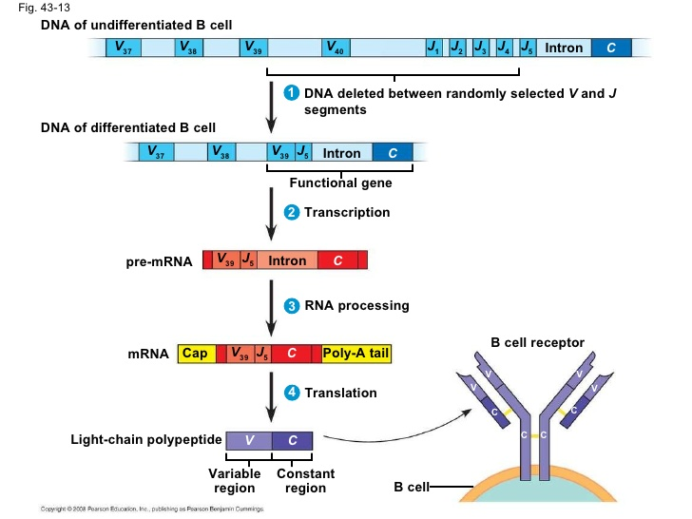
B cell diversity
In order for the immune system to be able to recognize a large variety of pathogens, there must be a mechanism to generate antibody diversity
An antibody has three segments: a variable segment, a joining segment, and a constant segment.
Genetic recombination through the enzyme recombinase generates diversity.

Slide 12
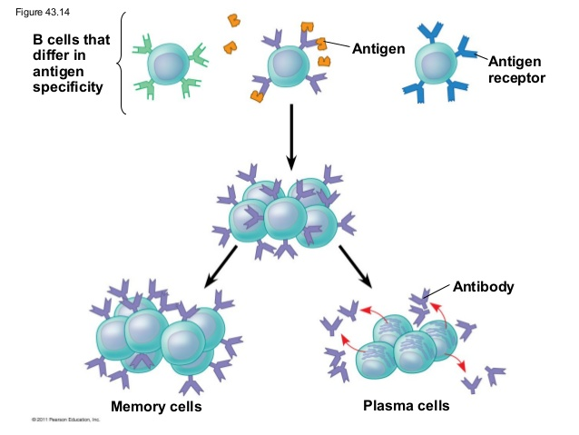
Clonal Selection
The binding of an antigen receptor to the epitope activates the lymphocyte
The activated lymphocyte undergoes multiple cell divisions.
Some cells from this clone become effector cells, which immediately attack the antigen, while others are memory cells.

Slide 13
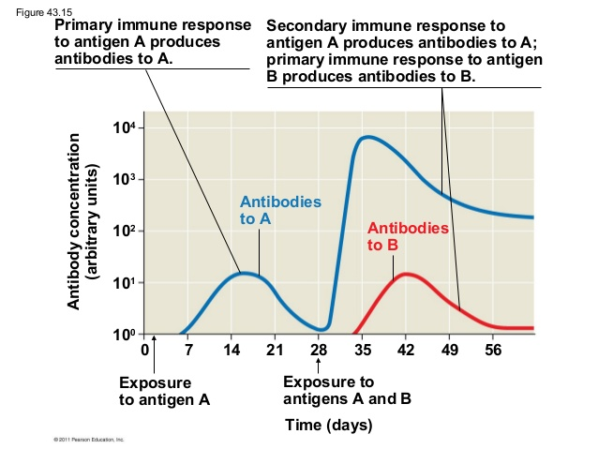
Secondary Immune Response

Slide 14
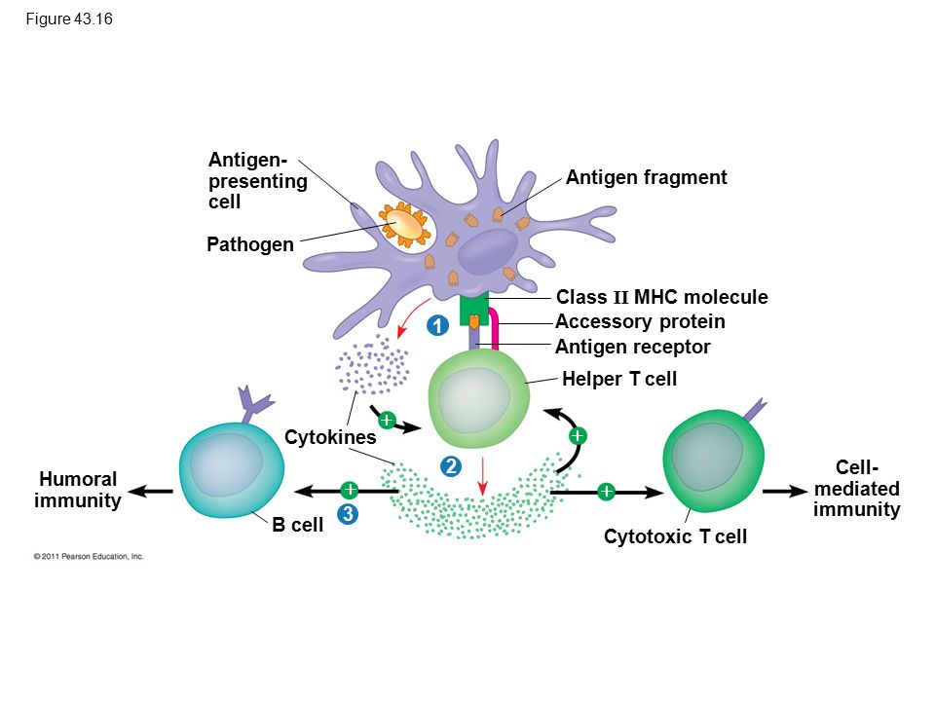
Helper T-cells
Helper T cells trigger both B cells and T cells.
It activates adaptive immune responses if an antigen is displayed on the surface of an antigen presenting cell.
Cytokines are released by the helper t-cell and the dendritic cell.

Slide 15
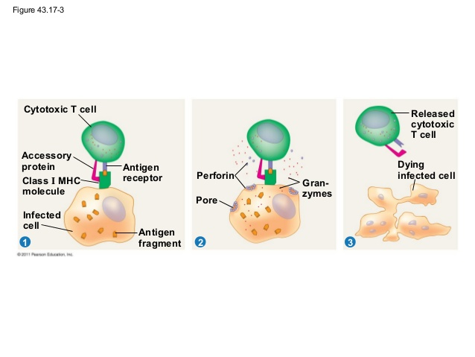
Cytotoxic T cells

Slide 16
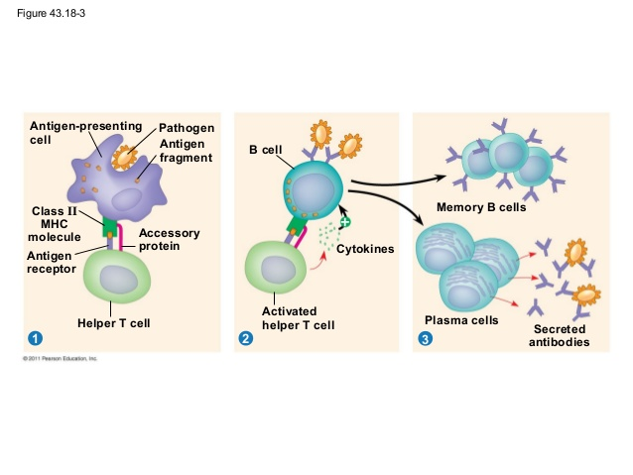
B cells and Antibodies
After an antigen engulfs a pathogen, it displays an antigen fragment complexed with an MHC 2 molecule on its surface. A Helper T cell recognizes this.
When a B cell with receptors for the same epitope displays the antigen, the activated helper T cell binds to the B cell and activates the B cell.

Slide 17
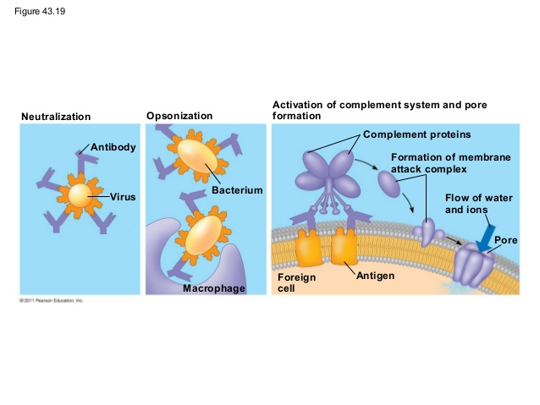
Antibody Function
Antibodies do not directly kill pathogens, but they bind to pathogens to mark these pathogens for destruction or inactivation.
In neutralization, antibodies bind to surface proteins and prevent the infection of a host cell
Opsonization allows macrophages to perform more phagocytosis
A membrane attack complex forms a pore in the cell membrane. Water and ions rush in and cause the cell to lyse.

Slide 18
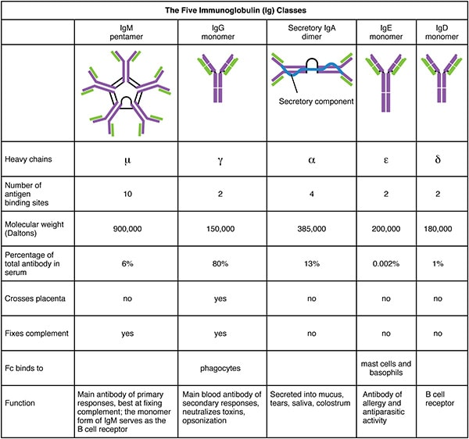

Slide 19
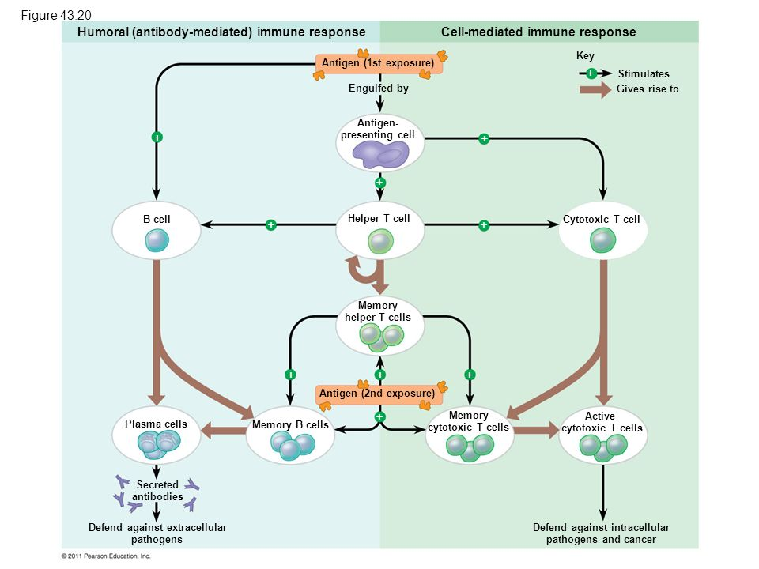
Overview of Adaptive immunity

Slide 20
Active and Passive Immunization
Active immunity arises when a pathogen infects the body and prompts a primary or secondary response
Passive immunity occurs when antibodies cross the placenta to the fetus.
Active immunity can develop from the introduction of antigens in the body through immunization or vaccination.
Monoclonal antibodies are all identical and produced for the same epitope. They have provided the basis for many medical advances, like pregnancy tests.

Slide 21
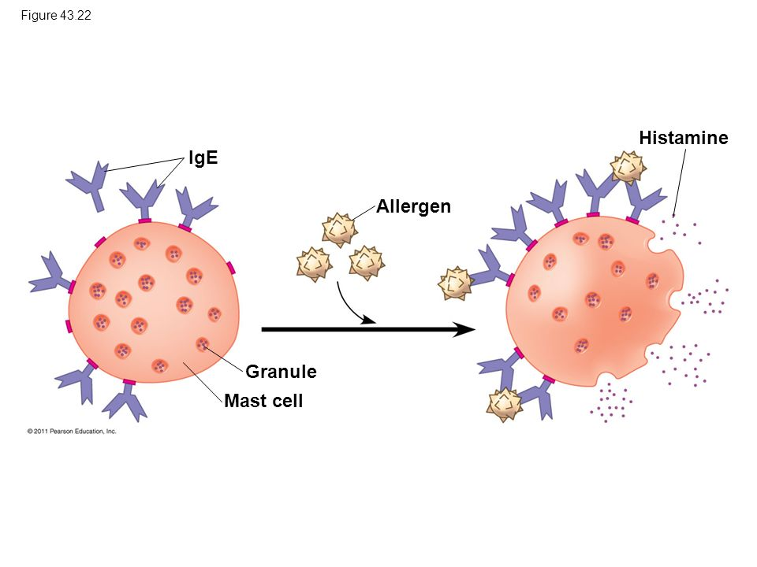
Allergic Response

Slide 22
Autoimmune Diseases
Usually, the body eliminates self-reactive lymphocytes by testing them during development. If the cells have receptors specific for the body’s own molecules, apoptosis occurs.
If this process does not occur properly, autoimmune diseases can occur.
The immune system is active against molecules of the body in an autoimmune disease.
In Lupus, the immune system generates an attack against DNA. This causes skin rashes, arthritis, and kidney disfunction.
Rheumatoid arthritis leads to damage and painful inflammation of the cartilage.
T cell attack the nervous system in Multiple sclerosis. This leads to paralysis due to impaired neurons.

Slide 23
HIV
Immunodeficiency is where an immune response to an antigen is absent or defective.
An inborn immunodeficiency results from a genetic mutation, while an acquired immunodeficiency develops later in life.
AIDS is caused by the HIV virus. The HIV virus infects Helper T-cells, which impairs both the humoral and cell-mediated responses.
Latency is a stage of dormancy in the virus life cycle. The viral genome persists in the DNA of cells but doesn’t cause any effects. Latency persists until conditions arise that are favorable for the virus.

Slide 24
